Slide 1

Welcome to the
(Special Edition)

Slide 2
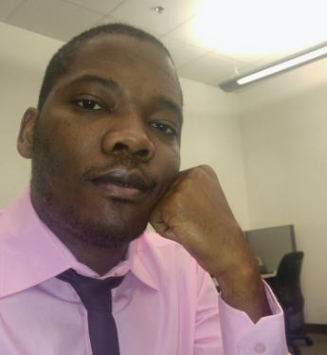
Hinault Donfack
Passionate About Coding
MCSD App Builder
MCP Azure
Technical Manager .NET Section Developpez.com
@hinault
Linkedin.com/en/hinaultdonfack
rdonfack.developpez.com

Slide 3
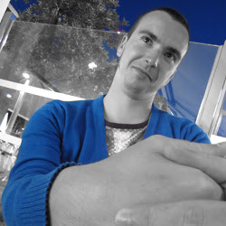
Mathieu Benoit
{
"firstName": "Mathieu",
"lastName": "Benoit",
"city": "Quebec",
"country": "Canada",
"company": "Microsoft",
"role": "Cloud Solution Architect",
"gitHub": "mathieu-benoit",
"blog": "aka.ms/mabenoit",
"misc": [
"software development",
"cloud + web + mobile",
"agile & devops enthusiast",
"continuous learning"
]
}

Slide 4

Frank Boucher
Cloud Solution Architect
Lixar
MVP Azure, Azure P-Seller
@fboucheros
linkedin.com/in/fboucheros
frankysNotes.com
cloudenfrancais.com

